Slide 1

Dawood University of Engineering & Technology
COURSE : HS- 1002
PAKISTAN STUDIES
LECTURER: FAISAL

Slide 2
.
Course Outline:
Indus Valley Civilization
Arab Invasion 712 AD.
Mahmud Ghaznavi 997-1030
M. Ghauri 1173-1206
Mughal Empire 1526-1857
War of Independence 1857
Sir, Syed Ahmed Khan
Allama Muhammad Iqbal
Quaid-e-Azam M. Ali Jinnah
Freedom Movement 1905-1947.
Political & Constitutional History of
Pakistan: 1947-58, 1958-71, 1971-77
1977-88, 1988-99, 1999-2008, 2008-25
13. Human Rights
14. Location & Physical Features of Pakistan.
15. Foreign Policy of Pakistan & Challenges

Slide 3
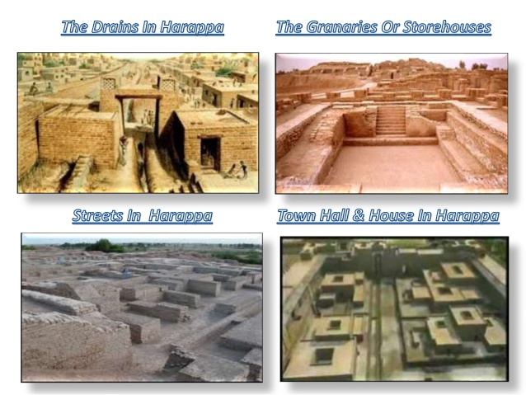
Indus Valley Civilization?

Slide 4


WHAT IS CIVILISATION?
The stage of human social development and organization which is considered most advanced.
Or simply, the society, culture and lifestyle of people in a particular area

Slide 5
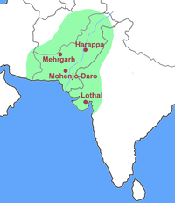
Some of the earliest settlement in the world are found Pakistan. Early Stone age live Potwar, near Soan river & site of Seria Khola in Punjab, Mehrgarh in Balochistan & Kot Daji in Sindh. Around 4000 B.C. People moved from hills to plains. & Urban Culture formed like Kot Daji & Mehargarh. The Indus Valley Civilization was the one of the world’s great urban civilization. (2800 sites) Indus Valley Civilization was a Bronze age Civilization (3000-1300 BC), It was first Discovered in 1842 by Charles Masson. It covered an area of 12,99,600 Sq.metre First serious efforts were made by Daya Ram Sahani under the leadership of John Marshall and Finally, an excavation campaign was started under Sir John Hubert Marshall in 1921-1922. Mohen jo Daro is about 45 feet above the plain. Mohen jo Daro covers 250 acres.

Slide 6
Four Phases of Indus Valley Civilization Historian Divided Indus Valley Civilization into four phase:
The Pre-Harappan (Indus Valley Civilization) from 3300 to 3000 BCE
The Nomadic people started living, settled and picked up agriculture.
The Early Harappan (Indus Valley Civilization) from 3000 to 2600 BCE
Villages & Urban centers' emerged in Indus Valley Civilization.
The Mature Harappan (Indus Valley Civilization) from 2600 to 1900 BCE.
Urban center flourished in the Indus Valley Civilization.
The Late Harappan (Indus Valley Civilization) from 1900 to 1300 BCE.
In this phases Decline of Civilization were observed.

Slide 7
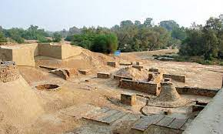
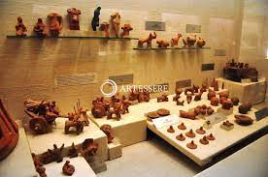
HARAPPA
Harappa (Sahiwal, Punjab) was the other major city in the Indus Valley Civilization.
It was identified on the bank of the Ravi river in 1920-1921.
It was the trading centre of the state. They show the government plans to counter attacks of invaders on the city. The city was similar in construction to Mohan-jo-Daro.
During the excavation many things were discovered such as solid clay pots, measuring & weighing tools, copper, silver & clay seals portraits & elephants made of bronze.
Tools, such as knives, saws, Chisels, & ornaments like bangles showed their living standards & advancement of their culture.

Slide 8
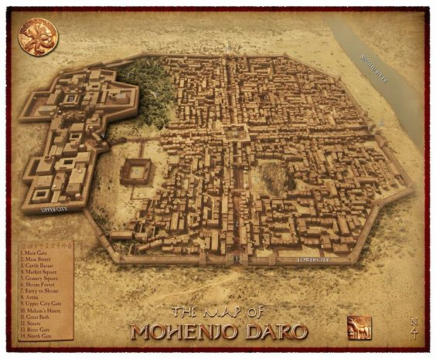
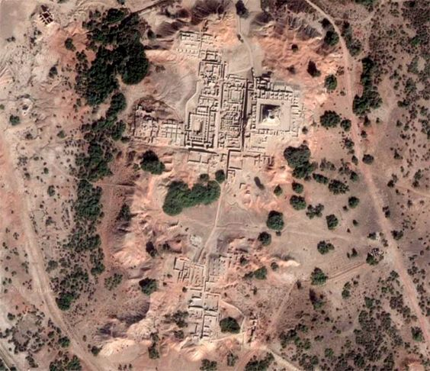
Citadel/Religious Town and Resident Town

Slide 9
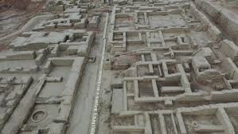
Planned Cities: The cities of IVC were well organized and solidly built out of bricks and stones. The people of the Indus Valley civilization are considered to be the first ever town planners of the human history. Citadel Religious Town

Slide 10
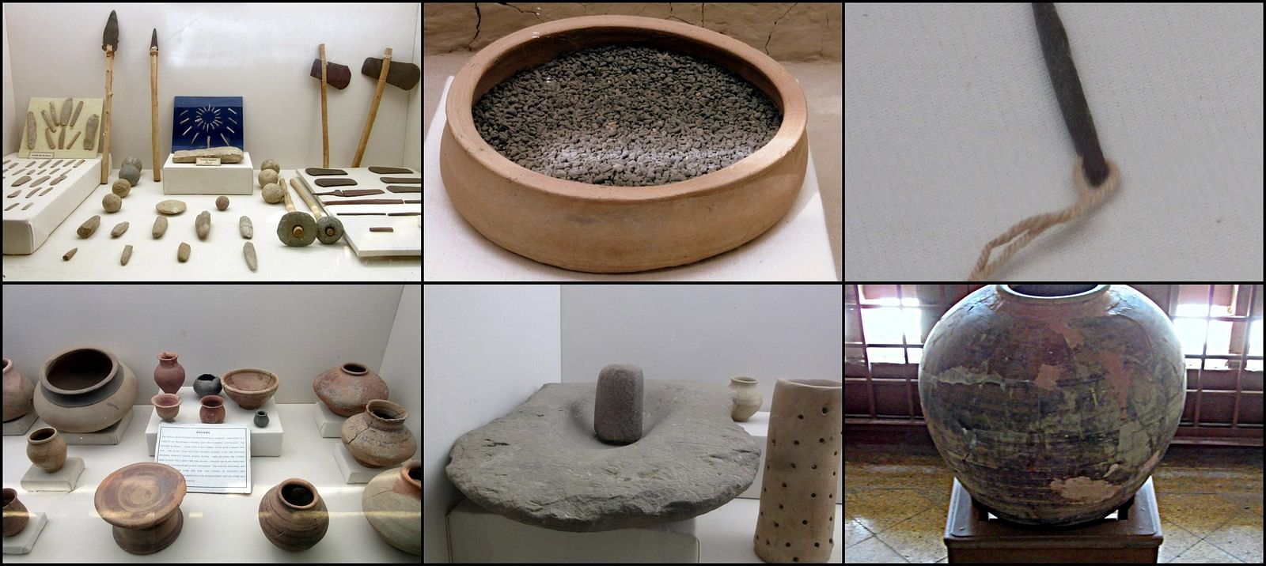
Pots and Weapons: The Indus Valley Civilization had craftsmen skilled in woodcraft. They were highly skilled in pottery, weaving & metalwork.

Slide 11
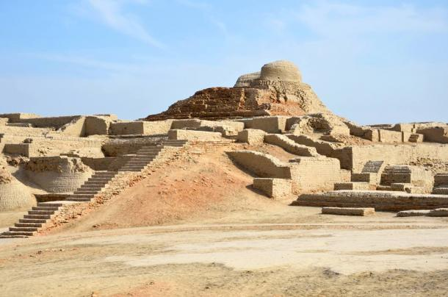
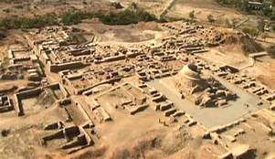
Mohen Jo Daro: Mohen jo Daro is divided in two sites Religious Town Lower Town (City) Used commercial and religious Resident area

Slide 12
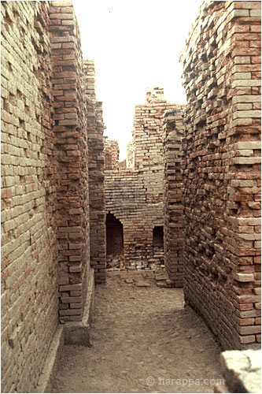
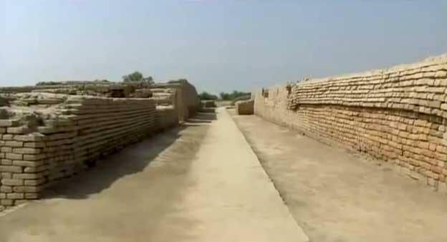
Streets: Streets intersected one another at a 90-degree angle. 30 feet wide average of Street.

Slide 13
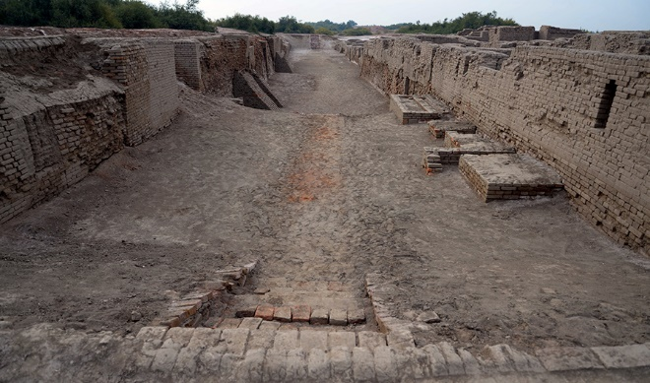
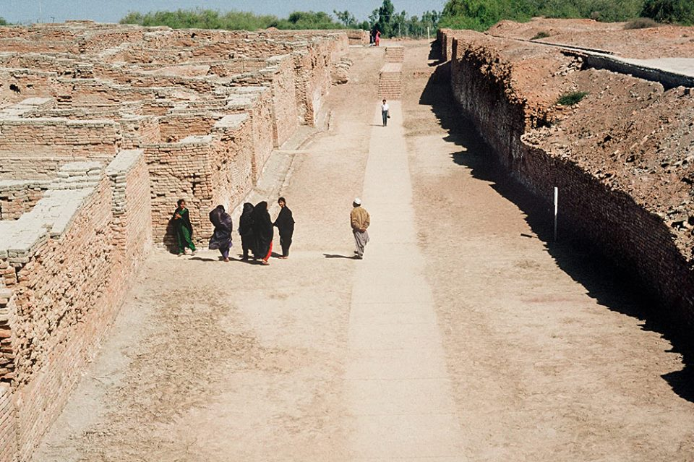
Main Street:

Slide 14
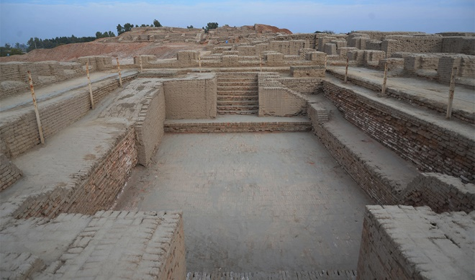
Great Bath: Many baths were found in the ruins which shows their cleanliness & hygienic practices. The great bath (12x7 m wide and Its depath is maximum 2.4 m) of Mohan-jo-Daro was also used for rituals & bathing purpose. Small rooms around the great bath were also discovered, which might be the changing rooms or small bathrooms.

Slide 15
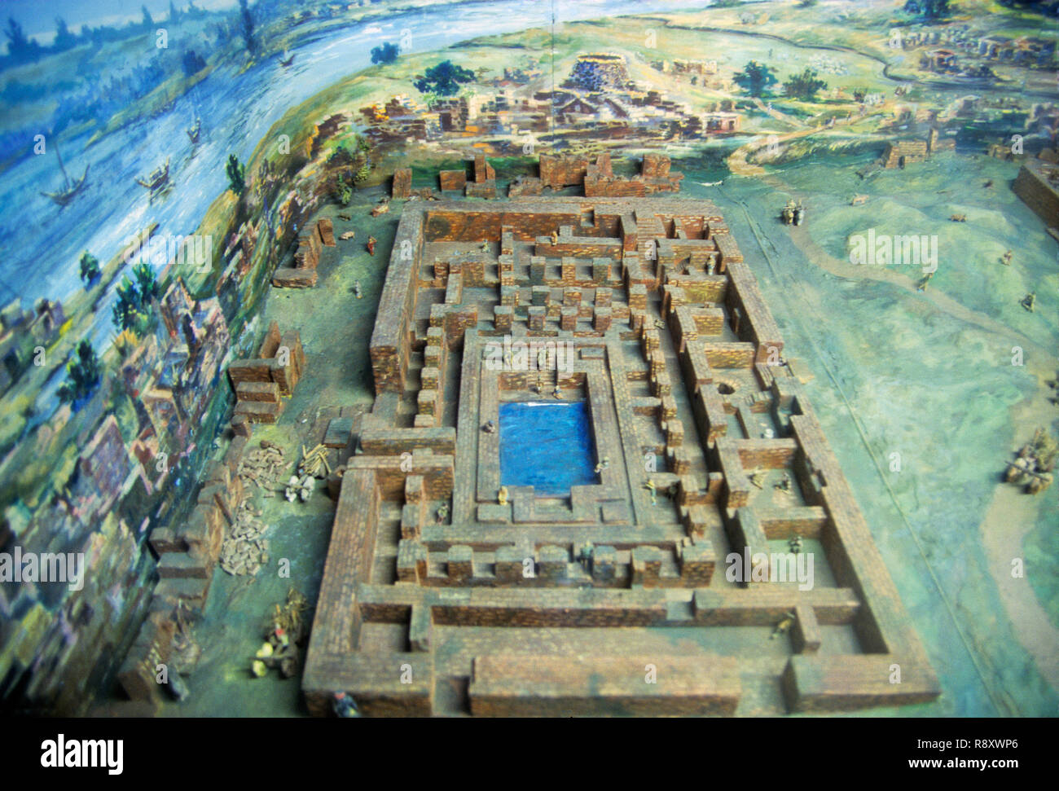
Great Bath:

Slide 16
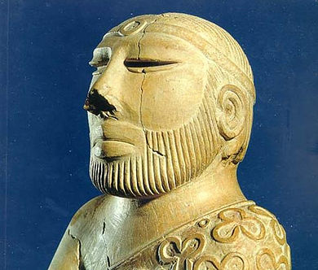
Government: There was no single ruler but several: The People of IVC enjoyed equal status. Sculpture founded from Mohen-jo-Daro called that Priest-King. Its height is 17.5 cm. Discovered in 1931.

Slide 17
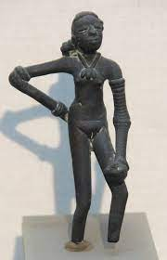
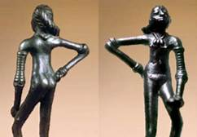
Sambara: Its height is 10.5cm founded in 1926.

Slide 18
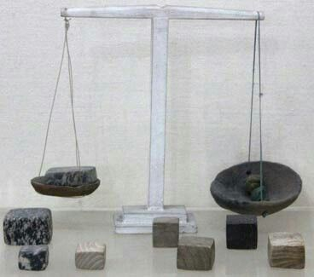
Scale: The people of IVC achieved great accuracy in measuring length, mass and time. They were among the first to developed a system of uniform weights and measure.

Slide 19
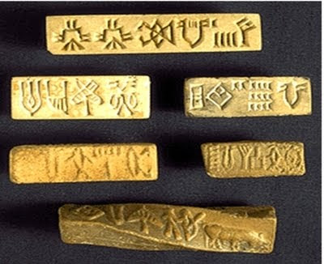
Writing: Between 400 and as many 600 distinct Indus symbols have been founded on seals, small tablets, ceramic pots and more then a dozen other materials.

Slide 20
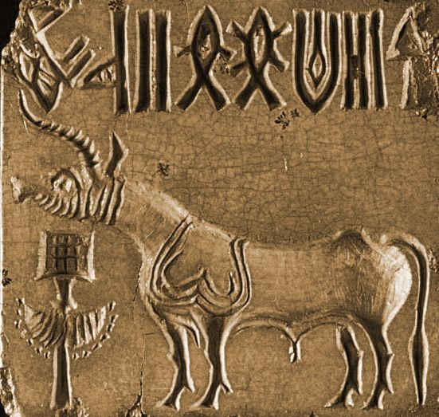
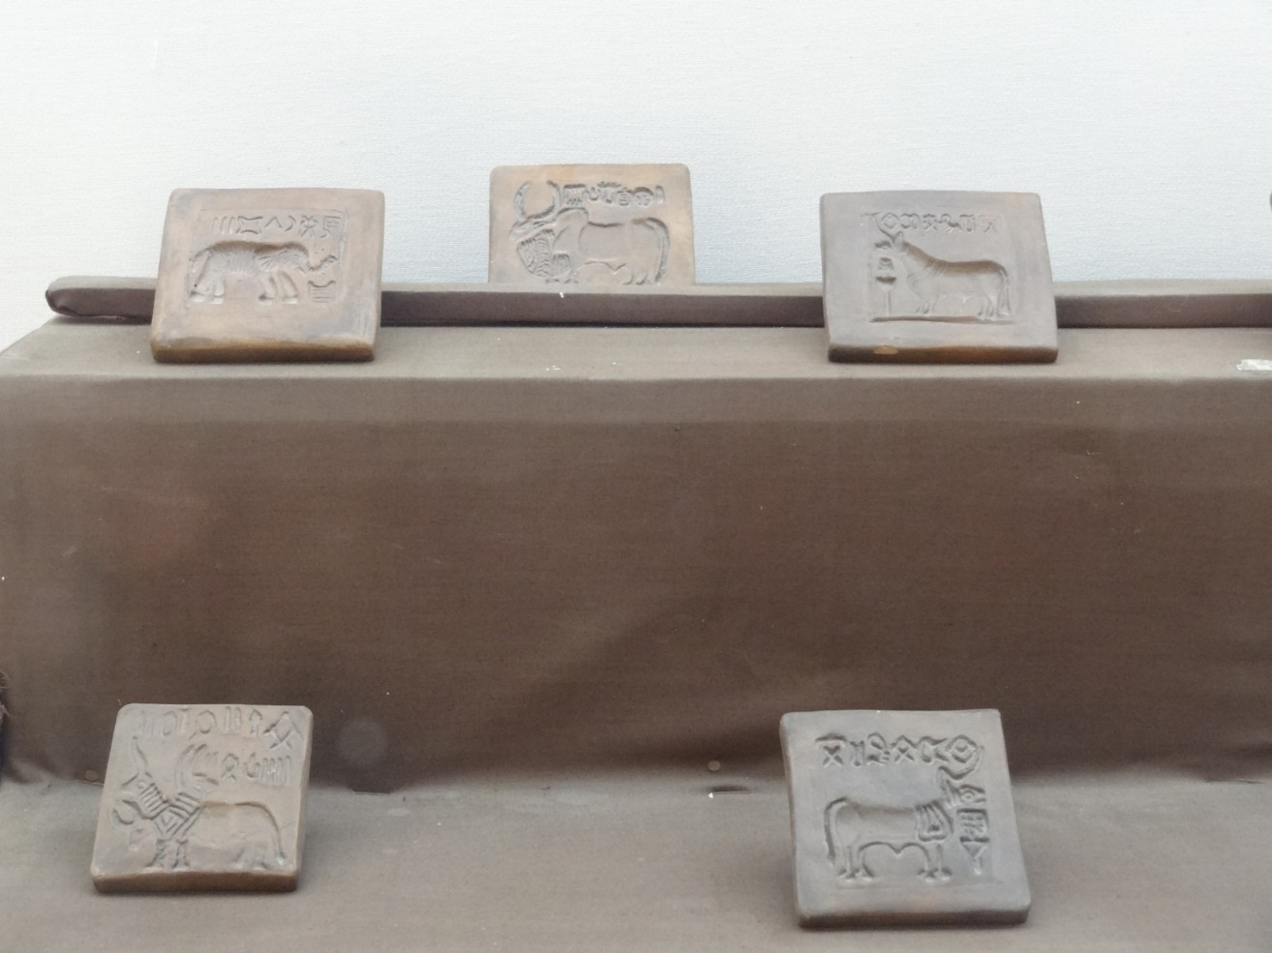
Seals There were 891 Seal found.

Slide 21
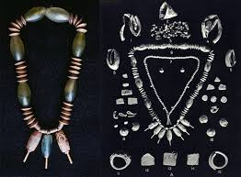
Jewelry: Various Sculptures and Women and Men were founded wearing different kind of Jewelry. Archaeologists have found evidence that Indus Valley people wore lots of jewelry, especially beads, necklaces, ear-rings and ear-studs, amulets, bangles and brooches.

Slide 22
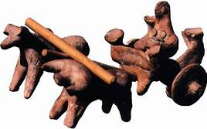
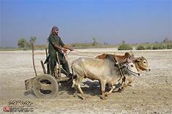
Bull and Cart: Indus Valley Civilization has been the first Civilization to used Wheel Transport.

Slide 23
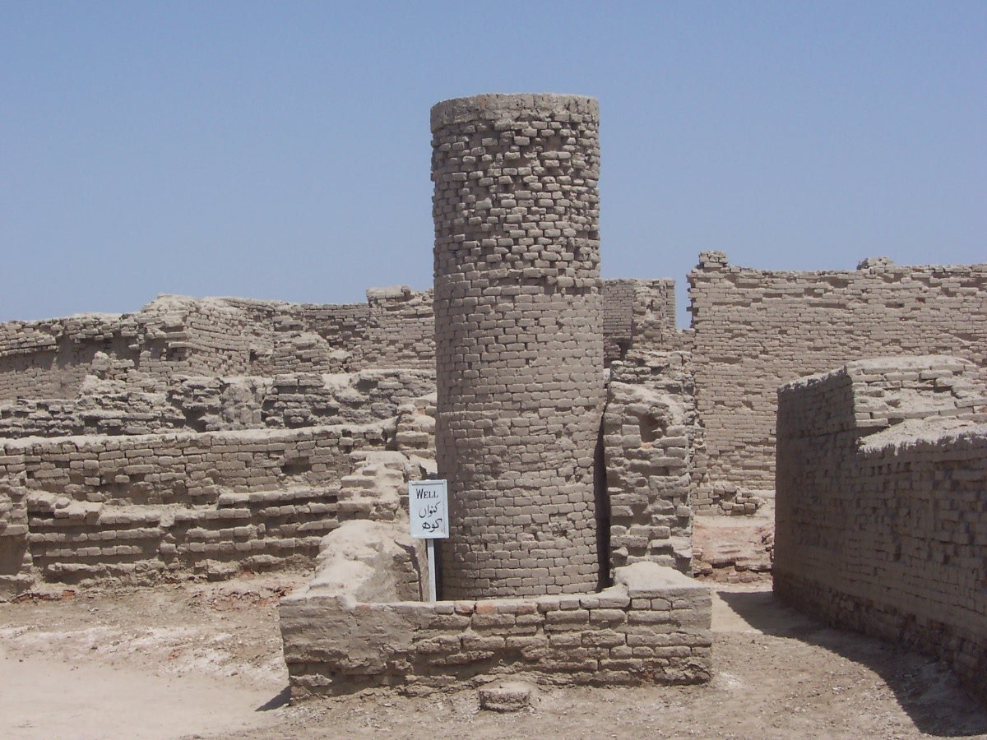
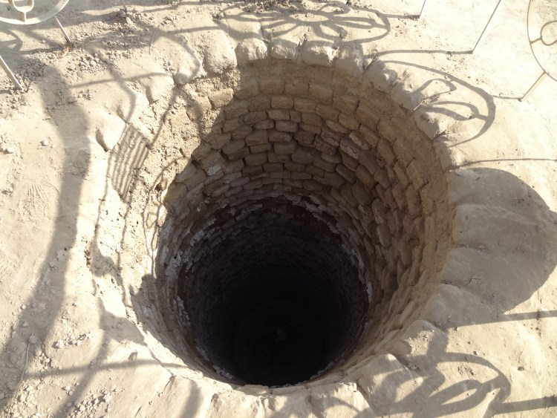
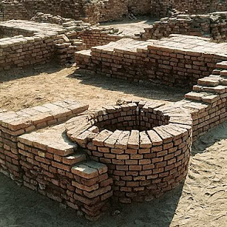
Wells

Slide 24
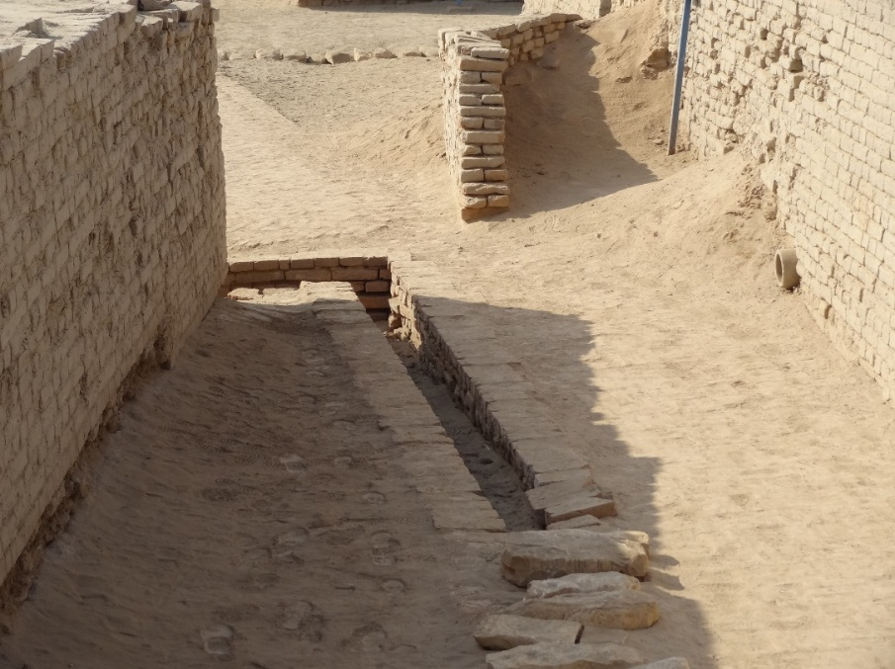
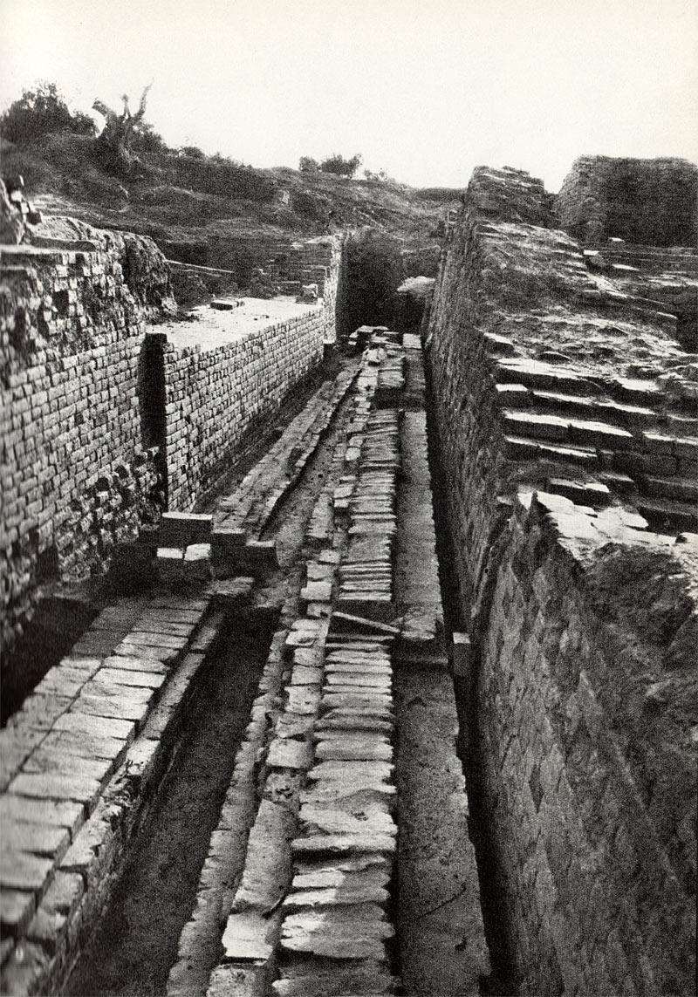
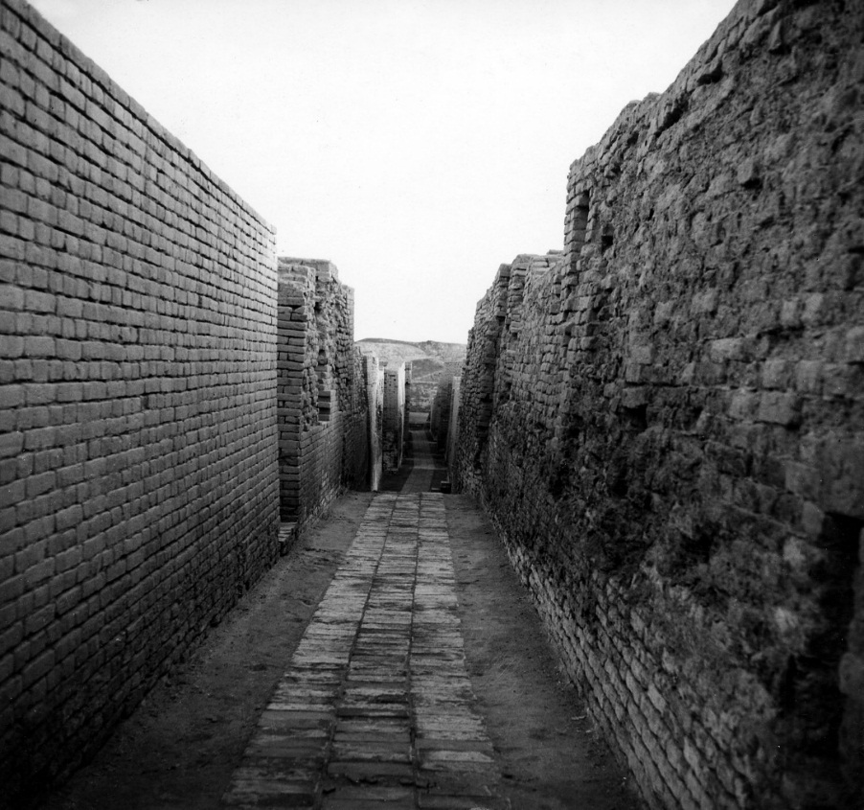
Drainage: There Drainage system was the most significant in the ancient world.

Slide 25
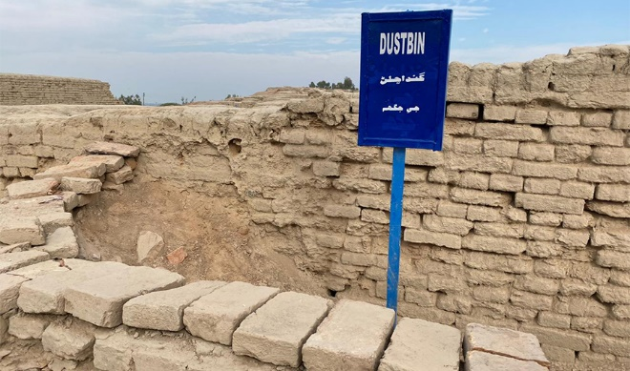
DustBin

Slide 26
Decline of Indus Valley Civilization:
Historian wrote that the Mohan-Jo-Daro destroyed Seven time!
They also believe that it was a combined of various factors:
Natural disasters, although not always immediate or singular, may have a role.
There are silt waste intervening between eras of settlement at numerous Indus towns, including Mohenjodaro, Chanhudaro, (Discovered in 1931 by the Indian archaeologist N. G. Majumdar.) and Lothal, highlighting the likelihood of devastation caused by swelling rivers.
Several layers of silt at Mohenjodaro show that the city was impacted by successive Indus floods, which led to the collapse of Harappan civilization.
Evidence of significant flooding appears to have separated distinct periods of occupancy in Mohenjodaro.
This type of catastrophic flooding and subsequent reconstruction appears to have occurred at least three times.

Slide 27
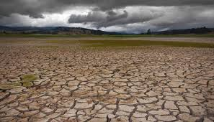
Climatic Change
According to D.P. Agarwal and Sood, the Harappan Civilisation fell when the region became more arid and the river Ghaggar-Hakra dried up.
They discovered that by the middle of the second millennium B.C., dry conditions had increased.
It would have an impact on agricultural productivity, putting city economies under strain.
Decline of Trade
The fall of the lapis lazuli commerce with Mesopotamia, according to Shereen Ratnagar, was a factor in the Harappan civilization's demise.
However, whether this commerce was extremely important to the Harappans is questionable; hence, it could not have been a role in their demise.

Slide 28
Decline of Indus Valley Civilization(cont.)
The Evidence Of Natural Disaster: The most common held theory used to explain the decline of the Harrapan culture is that climatic changes lead to a long term drought. This environmental disaster, coupled with repeated floods that devastated the arable land.
The Possibility Of An Ancient Tsunami: Some geophysicists have begun to theorize that such a disaster could have been responsible for the end of Harrapan civilization. This theory is based upon the premise that a massive wave could have reached inland, traveling up the Indus and Saraswati Rivers simultaneously.
The Saraswati River Runs Dry: The geological record does show that the Saraswati River, one of the main arteries of trade for the Harrapans, dried up completely sometime during the early 20th century B.C.E.

Slide 29
Conclusion:
The River Indus altering its course, & weather patterns.
A climate change, resulting in the spread of drought condition.
The rise in the water table and Salinity and Water Logging were threatening the volume ruins at Mohan-Jo-Daro.
Regular invasions by Aryan Tribes from Central Asia and Persia.
Many experts think that climatic change was to blame for the fall of the Indus Valley Civilization. Most Harappan towns had been nearly totally abandoned by 1800 BCE. The communities in the foothills eventually declined as well. Some scholars believe that the drying of the Saraswati River, which began approximately 1900 BCE, was the primary cause of climatic change, while others believe that a large flood hit the area.
Note: Mohan-Jo-Daro included in World Heritage Site in 1980 by UNESCO.

